Slide 1

Finetuning Meta’s Llama LLM to Extract Closure Information From Long National Park Comments
Austin Lackey
This Image Is Generated by DALLE3

Slide 2
Background
MONTH | COMMENT
January | South entrance closed for construction.
February | Annual Parade drove v…
March
… | …
Example Scenario
ENTRANCE/ LOCATION | JAN | FEB | MAR | ….
North Counter | 401 | 200 | 189 | …
South Counter | 0 | 147 | 235 | …
Alpine Peak Trailhead | 35 | 42 | 36 | …
Moose Lodge Campground | 0 | 90 | 80 | …
… | … | … | … | …

Slide 3
The Problem
MONTH | COMMENT
January | 1.) BAIS Ranger left position at beginning of the month. 2.) MIIN has had broken HVAC/air conditioning since June. Idaho has seen record number of days at temps of high 90s-100s; prolonged heat wave has resulted in MIIN Visitor Center closing 3 to 4.5 hours early to mitigate heat exhaustion amongst staff and visitors. 3.) Yellowstone temporarily closed due to severe flooding and, even after reopening, has seen decreased visitation due to cancelled travel plans or potential visitors not knowing that the park is open. A significant portion of MIIN visitation comes from the traffic between YELL and the Pacific Northwest, so MIIN visitation may have similarly decreased. 4.) A large portion of MIIN visitors are semi/retired RV travelers; MIIN visitation may have decreased due to high cost of gas throughout the summer (national average $5.00+). BAIS -- Estimated with a 10% decrease from July BAIS FY22 assumed from the lack of BAIS Ranger during the month of July. Bainbridge Island Japanese American Exclusion Memorial people counters have been broken since 03/2021. MIIN staff based out of Idaho and not able to easily make fixes to BAIS in WA state. The memorial is collectively cared for by the Bainbridge Island Japanese American Exclusion Memorial Association, the Bainbridge Island Japanese American Community, the Bainbridge Island Historical Museum, Bainbridge Island Parks & Recreation District and the Klondike Gold Rush National Historical Park - Seattle.
February | July, 2005 was an exceedingly hot month, with a few days that broke records. High heat in the mid to upper 90s with 70 to 80% humidity resulting in a high heat index. The excesive heat may have been responsible for lower vistation numbers at the Elizabeth Cady Stanton House, which is not air conditioned. The staff at the information desk is careful to inform visitors of this fact on hot days, so that those who have trouble with the heat may make an informed decision on whether or not to take the tour. 4-Jul: Special Event-Reading of the Declaration of Sentiments- 9 10-Jul: AAVW- 13, chapel, film, exhibits, Stanton 11-Jul: Syracuse University- 52 15-Jul: Methodist Center- 20 17-Jul: Women's (Democratic Politicians) Event in Chapel 10:10-10:40 am (Samara Barend for Congress)- 10; Women's Rights Convention Dramatization- 150, 2pm; Fix Air Conditioning!!! 19-Jul: Camp Wanepee- 13 20-Jul: Fix Air Conditioning on 1st Floor!! Had a few complaints from guests. 21-Jul: Rochester Int'l Council ”…………………………………………..
… | ….
400 Parks
12 Months of data
12x400=~4,000 comments
3-5 Iterations….

Slide 4
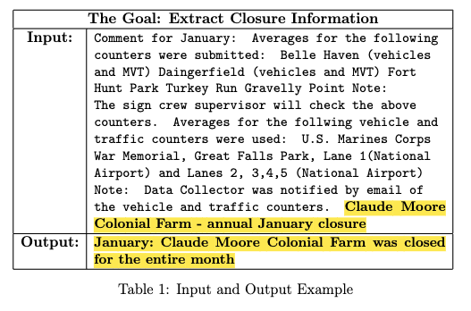
The Goal
Turn long verbose comments into concise closure-specific segments.

Slide 5


LLMs are great but...
$$$

Slide 6
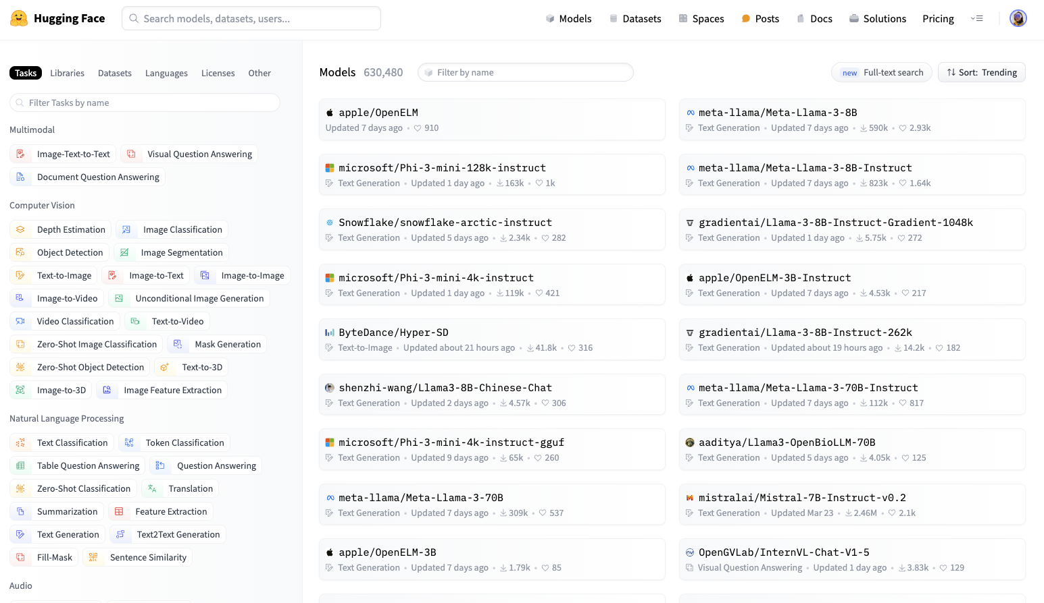
The Goal

Slide 7
